Slide 1
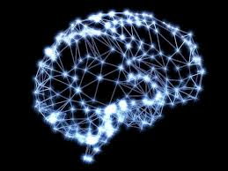


VISVESVARAYA TECHNOLOGICAL UNIVERSITY (VTU), BELGAUM S J B INSTITUTE OF TECHNOLOGY
DEPARTMENT OF ELECTRONICS
AND
COMMUNICATION ENGINEERING
ARTIFICIAL NEURAL NETWORK BASED IMAGE PROCESSING FOR WILD ANIMAL DETECTION AND MONITORING
Team Members:
Raksha.V 1JB13EC075
Shwetha.H.R 1JB13EC098
Poornima.K 1JB13EC119
Archana.H 1JB14EC401
Under The Guidance Of :
Mr. Supreeth.H.S.G
Asst Professor
Dept Of ECE

Slide 2
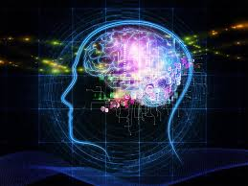
CONTENTS
ABSTRACT
INTRODUCTION
LITERATURE SURVEY
OBJECTIVE & SCOPE
METHODOLOGY
FLOW CHART
FOREGROUND DETECTION
GAUSSIAN MIXTURE MODEL
MORPHOLOGICAL FILTER
BOUNDING BOX
BACK PROPAGATION
RESULTS
APPLICATIONS
CONCLUSION
REFERENCES

Slide 3
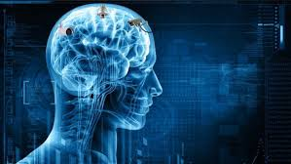
ABSTARCT
Animal detection plays a important role in day to day life. In the agricultural areas near the forest many animals destroys crops or even attack on people therefore there is a need of system which detects the animal presence and gives warning about that in the view of safety purpose.
In this project the aim is to recognize the wild animal which enters the human habitation so that both wildlife and human life is secured.
caltec-101 is used as the database for the training purpose. The database is trained using back propagation neural network.
Foreground detector is applied for the detection of the movement. Extraction of foreground animal using Back ground subtraction based Gaussian mixture model.
Gaussian mixture model is well suited for extraction process of back ground because its reliability against changes in light and condition during repeated object detection.
Test image is compared with all the trained images. If all the trained images are compared then the animal is recognized

Slide 4

INTRODUCTION
In india 24% of the area is covered by forest. So, most of the people live around the forest to fulfill their needs.
Now the lives of both animals and humans are under threat. There is a need to implement warning system to make sure human and wild animals live safely.
This project aims in detecting and recognizing the animal when the animal tries to enter human habitation.
The recognition is done using foreground detector.
The detection is done using backpropagation neural networks.

Slide 5
LITERATURE SURVEY
[1] “Implementation of Back Propagation Algorithm: A Neural Network Approach for Pattern Recognition”, Taranjit Kaur, International Journal of Engineering Research and Development, June 2012.
In this Paper, two scenarios are considered. First is tracking a Leopard when no other animal is present. Second one is tracking a Leopard in the presence of other animal.
Tracking of a Leopard is implemented in Simulink using Horn – Schunck and Lucas – Kanade method of Optical Flow, and also the Background Subtraction method.
[2]“Detection of Moving Objects using Foreground Detector and improved morphological filter”, Adedeji Olugboja & Zenghui Wang, 2016 3rdInternationalConferenceon Information Science and Control Engineering.
Gaussian Mixture Model(GMM)is applied, which is established on background subtraction. Smoothing method was used for the pre-processing stage and morphological filter was applied to remove the unwanted pixels out of the background in other to resolve the background noise disruption problem.

Slide 6
Contd…
[3] “A vision based human-elephant collision detection system”, Isha Dua, Pushkar Shukla, Ankush Mittal , Third International Conference on Image Infonnation Processing, 2015.
Regions with higher human movements like roads were extracted from the initial video frames. The objects in the area of motion are then identified as elephant or non-elephant with the help of Support Vector Machines (SVM) classifiers.
A dataset constituting of images of elephants and other objects was used for training the proposed algorithm.
[4] “Adaptive background mixture models for real-time tracking” , Chris Stauffer and W.E.L Grimson.
This paper discusses modeling each pixel as a mixture of Gaussians and using an on-line approximation to update the model. The Gaussian distributions of the adaptive mixture model are then evaluated to determine which are most likely to result from a background process.
This results in a stable, real-time outdoor tracker which reliably deals with lighting changes, repetitive motions from clutter, and long-term scene changes.

Slide 7
Contd…
[5] “A Gaussian Mixture Model with Gaussian Weight Learning Rate and Foreground Detection using Neighborhood Correlation” , Deepak Kumar Panda & Sukadev Meher, IEEE Asia Pacific Conference on Postgraduate Research in Microelectronics and Electronics, 2013.
In this paper a new Gaussian weight learning rate for Gaussian mixture model based background subtraction is presented. The foreground detection is done by exploiting the neighborhood correlation of a pixel.
The algorithm fails to detect shadow.
[6] “Background Modeling using Mixture of Gaussians for Foreground Detection”, Thierry Bouwmans, Fida El Baf, Bertrand Vachon.
Developers to choose the appropriate improvement to tackle the critical situations met in their application.
Researchers to have a recent state-of-the-art and so easily identify new ideas to improve the MOG.
Reviewers to verify quickly the originality of a paper.

Slide 8
Contd…
[7] “Improved Back-Propagation Algorithm for Neural Network Training”, Balazs Tusor .
Fuzzy Neural Networks (FNNs) are the combinations of ANNs and Fuzzy logic in order to incorporate the advantages of both methods (learning ability of ANNs and the thinking ability of Fuzzy logic).
Circular Fuzzy neural Networks (CFNNs) are FNNs with their topology realigned to a circular topology and the connections between the input layer and hidden layer trimmed.

Slide 9
OBJECTIVE & SCOPE
To develop an algorithm to detect the wild animal.
Extraction of moving animal using foreground detection.
To design the algorithm using the Artificial Neural Network/Back propagation.
Back propagation is used for training & foreground detection algorithm is used for testing.
Display the detected animal.

Slide 10
METHODOLOGY
INPUT VIDEO
IMAGE DETECTION USING FOREGROUND DETECTOR
TEST
IMAGE
IMAGE CROPPING USING BOUNDING BOX
RECOGNITION USING ANN BACK PROPAGATION ALGORITHM
RECOGNIZED OUTPUT
TRAINED IMAGE
TRAINING DATASET

Slide 11
FLOW CHART
INPUT VIDEO
FOREGROUND DETECTOR
IF ANIMAL DETECTED
N
Y
CROP IMAGE
BACK PROPAGATION ALGORITHM
TRAINING IMAGE DATASET
N
Y
RECOGNIZED OUTPUT

Slide 12
FOREGROUND DETECTOR
Foreground detection is one of the major tasks in the field of computer vision whose aim is to detect changes in image sequences.
Extracting the foreground Object is important when grouping, tracking and investigating the activities of the interested object, which is why background subtraction was being used.
A very good foreground detection system should be able to:
Develop a background (estimate) model.
Be robust to lighting changes, repetitive movements (leaves, waves, shadows), and long-term changes.
Background subtraction is based on Gaussian mixture model.
Morphological filters are used to remove the noise.

Slide 13
GAUSSIAN MIXTURE MODEL
GMM is a density model that consists of several Gaussian component functions.
This method can perform well when used for extraction process of background because its reliability against the changes in light and condition during repeated object detection.
Pixel in the video scene is modeled in Gaussian distribution. Each pixel in the frame was compared with model formed from GMM.
If the color of pixel is categorized as a background model then the pixel will be given zero (0) or black color. While the pixel is uncategorized in background model then it will be considered as foreground and given one (1) or white color.

Slide 14
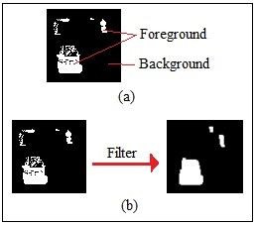
MORPHOLGICAL FILTER
Background subtraction, using GMM, the output contain a lot of noise and the moving object become separated, Erosion and dilation are the two fundamental operations of morphological filtering.
In our paper we will be using the opening filter, which was successfully applied to binary image.
Morphology operation is a filter That combines between erosion and dilation process in binary or grayscale image.
Fig (a)shows the foreground object and detected background.
Fig(b)shows filtering on morphology.

Slide 15
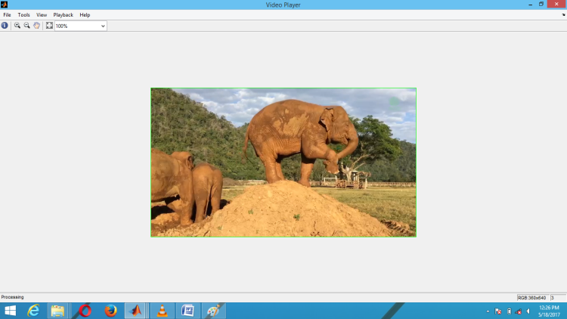
BOUNDING BOX
The detected foreground object is adapted with blob area. The object corresponding with blob area is detected as the vehicle object and marked by a bounding box.
A bounding box connecting component corresponding to the moving car. Any blob which is less than 150 pixels is rejected.

Slide 16
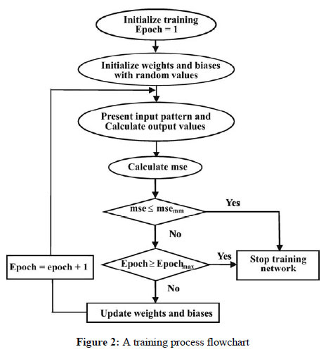
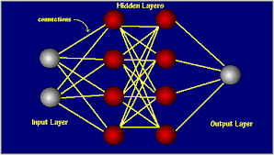
BACK PROPAGATION

Slide 17
Contd…
The back propagation algorithm operates in two phases:
1. Training phase.
2. Error detection phase.
The final output of the network is eventually computed by the activations from the output layer.
Hidden layer plays a major role detection of animals since it contains all the features of trained images.

Slide 18
RESULTS
Input Video | Total Number of Frames | Frames in which Animals are Detected | Correct Recognition of Animal | Recognized Result
Cheetah | 98 | 44 | 32 | 72.72%
Bear | 81 | 22 | 16 | 72.72%
Elephant | 112 | 51 | 39 | 76.47%

Slide 19
Graphical representation of comparision of recognition rate

Slide 20
APPLICATIONS
A great help to forest department in animal monitoring.
Prevent loses of life and vegetation due to animal entering human habitation.
Prevent chaos created by wild animal entering human habitation.
Safeguard the wild life as well as human life.

Slide 21
CONCLUSION
Wildlife monitoring is important for effective protection of wildlife and human life, safeguard human habitat, sustainable use, and scientific management of wildlife resources.
Compared to the traditional wildlife monitoring methods, wildlife monitoring based on artificial neural network image processing is more efficient.
From all these results we conclude that, background subtraction method gives us better and accurate result for moving animal detection. The proposed method uses Back subtraction based Gaussian mixture model because it is well suited for various lighting intensities and also in deletion of repeated frames.
Back propagation ANN is used here because it is computationally less complex and is very effective. Performance analysis shows the recognition result of the proposed method.

Slide 22
REFERENCES
[1] “Implementation of Back Propagation Algorithm: A Neural Network Approach for Pattern Recognition”, Taranjit Kaur, International Journal of Engineering Research and Development, June 2012.
[2] “Motion Detection & Tracking of a Leopard in a Video”, Nitesh Sanklecha, Dr. Sudarshan Patil Kulkarni, International Journal of Advanced Research in Electrical, Electronics and Instrumentation Engineering ,August 2015.
[3] “Optical Flow Measurement using Lucas Kanade Method”, Dhara Patel & Saurabh Upadhyay, International Journal of Computer Applications January 2013.
[4] “Moving Object Detection with Moving Background using Optic Flow ”, Milin P. Patel &Shankar K. Parmar, IEEE International Conference on Recent Advances and Innovations In Engineering (ICRAIE-2014), May 09-11,2 014.
[5] “Moving Object Detection & Tracking Using Hybrid Approach in Real Time to Improve Accuracy”, Dhara Trambadia, Chintan Varnagar, Prajesh Kathiriya, International Journal of Innovative Research in Computer and Communication Engineering ,April 2015.
[6] “Motion Detection Using Lucas Kanade Algorithm and Application Enhancement”, Lee Yee Siong, Siti Salasiah Mokri, Aini Hussain, Norazlin Ibrahim, Mohd Marzuki Mustafa, International Conference on Electrical Engineering and Informatics, August 2009.
[7] “Image Recognition and Processing Using Artificial Neural Network”, Md. Iqbal Quraishi, J Pal Choudhury & Mallika De, Recent Advances in Information Technology, 2012.
[8] “Artificial Neural Image Processing Applications: A Survey”, Juan A. Ramírez-Quintana, Mario I. Chacon-Murguia and Jose F. Chacon-Hinojos.
[9] “Image Enhancement using Artificial Neural Network and Fuzzy Logic”, Shweta Narnaware & Roshni Khedgaonkar.

Slide 23
Contd…
[10] “Region Filtering and Optical Flow based Video Surveillance System”, Dolley Shukla, Surabhi Biswas International Journal of Computer Applications, February 2013.
[11] “Robust Optical Flow Computation”, B.H Alireza Bab-Hadiashar and S. David.
[12]“DetectionofMovingObjectsusingForegroundDetectorandimprovedMorphologicalfilter”, Adedeji Olugboja & Zenghui Wang, 2016 3rdInternationalConferenceon Information Science and Control Engineering.
[13] “Identifying Moving Objects in a Video using Modified Background Subtraction and Optical Flow Method”, Sumati Manchanda & Shanu Sharma, 2016 International Conference on Computing for Sustainable Global Development (INDIA Com).
[14 ]M. Piccardi (October 2004). Backgroud subtraction techniques: a review (PDF). IEEE International Conference on Systems, Man and Cybernetics. 4. pp. 3099 3104.doi:10.1109/icsmc.2004.1400815.
[15] B. Tamersoy (September 29, 2009). ”Background subtraction – Lecture notes” (PDF). University of Texas at Austin.
[16] B. Patel; N. Patel (March 2012). Motion Detection based on multi-frame video under surveillance systems. Vol. 12.
[17] N. Lu; J. Wang; Q. Wu; L. Yang (February 2012). An improved Motion Detection methodfor real time Surveillance.

Slide 24
Contd…
[18] Stauffer C, Grimson W. Adaptive background mixture models for real-time tracking. Proc IEEE Conf on Comp Vision and Patt Recog(CVPR 1999) 1999; 246-252.
[19] Friedman N, Russell S. Image Segmentation in Video Sequences: A Probabilistic Approach. Proceedings Thirteenth Conference on Uncertainty in Artificial Intelligence (UAI 1997), 1997; 175-181.
[20]Dempster A, Laird N, Rubin D. Maximum likelihood from incomplete data via the EM algorithm. J Royal Statistical Society, Series B (Methodological) 1977; 39(1): 1-38.
[21]M. Piccardi, “Background subtraction techniques: a review,” in Proceedings of the IEEE International Conference on Systems, Man and Cybernetics, vol. 4, 2004, pp. 3099-3104.

Slide 25

THANK YOU

